Slide 1
Capstone project
Telecom Churn Analysis
Girija Prasanna Swain
Sibani Choudhury

Slide 2

Content
Problem statement
Summary
Objective
Data Summary
Data cleaning
Exploratory Data analysis
Solution To Reduce customer Churn
Conclusion

Slide 3
Problem Statement
Orange S.A., formerly France Télécom S.A., is a French multinational telecommunications corporation. The Orange Telecom's Churn Dataset, consists of cleaned customer activity data (features), along with a churn label specifying whether a customer canceled the subscription.
Explore and analyze the data to discover key factors responsible for customer churn and come up with ways/recommendations to ensure customer retention

Slide 4
SUMMARY
Our Exploratory Data analysis Gonna perform the following steps:
Preview Data
Check total number of entries and column types
check the null values
Check any duplicate entries
Plot distribution of numeric data (univariate and pairwise joint distribution)
Plot distribution of Categorical Data
Analyse time series of numeric data by daily, monthly and yearly frequencies

Slide 5
OBJECTIVE
Customer churn occurs when customers stop doing business with a company.
As the cost of retaining an existing customer is far less than acquiring a new one, maintaining a healthy customer base is important for the success of any business
The main objective of project is to :
Finding factors which influence customers to churn.
Retain churn customers by applying strategy
Providing offers based on influencing factors.
Control churn rate and improve their image in the market.

Slide 6
Data Summary
This data set contains 20 categories with more than 3000 observations:-
State-51 unique states in United States of America
Account Length :how long account has been active
Area Code :Code Number of Area having some States included in each area code
lntl Plan :International plan activated ( yes, no )
VMail Plan : voice Mail plan activated ( yes ,no )
VMail Message :No.of voice mail messages
Day Mins :Total day minutes used
Day calls :Total day calls made
Day Charge :Total day charge
Eve Mins :Total evening minutes

Slide 7
Data Summary
Eve Calls :Total evening calls
Eve Charge :Total evening charge
Night Mins :Total night minutes
Night Calls :Total night calls
Night Charge :Total night charge
Intl Mins :Total International minutes used
Intl Calls :Total International calls made
Intl Charge :Total International charge
CustServ calls :Number of customer service caUs made
Churn :Customer churn (Target Variable True=1, False=0)

Slide 8
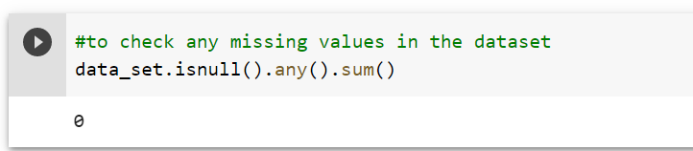
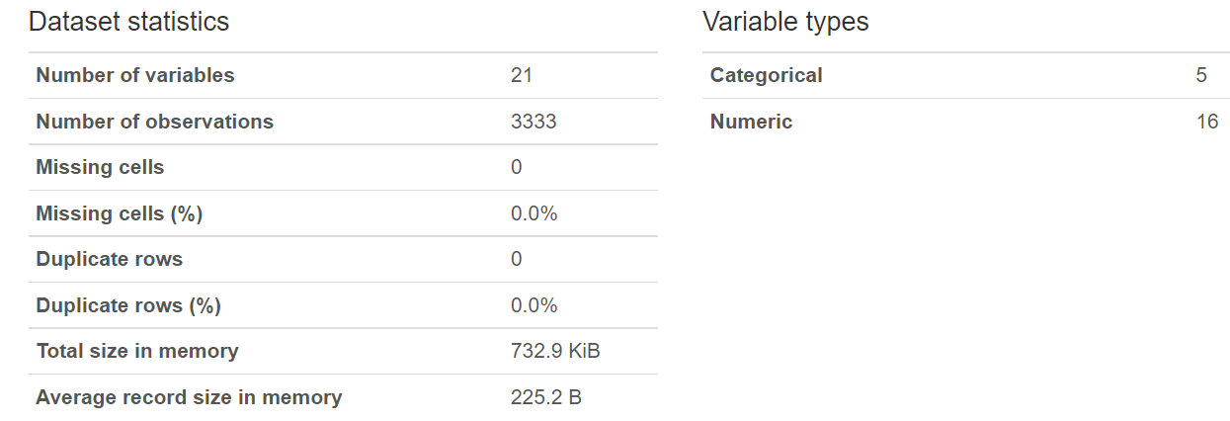
Data Cleaning
Checking the data for any missing Values.
Dataset Statistics-

Slide 9
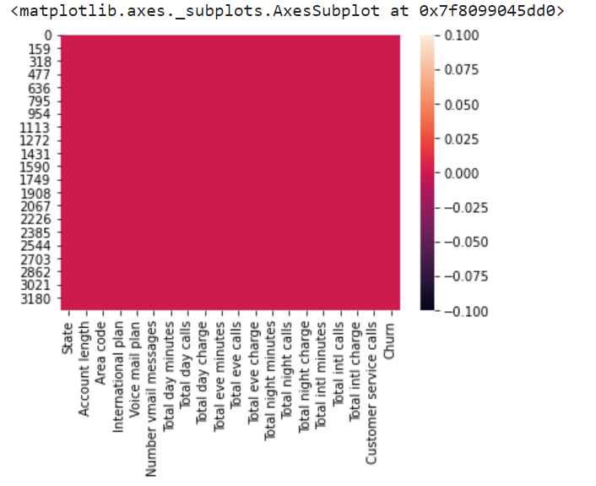
Data Cleaning
Checking Null Value by plotting
Heatmap
The heat map shows
the data has no
Missing values or
duplicate values.The data is now
Perfect for doing the EDA.

Slide 10
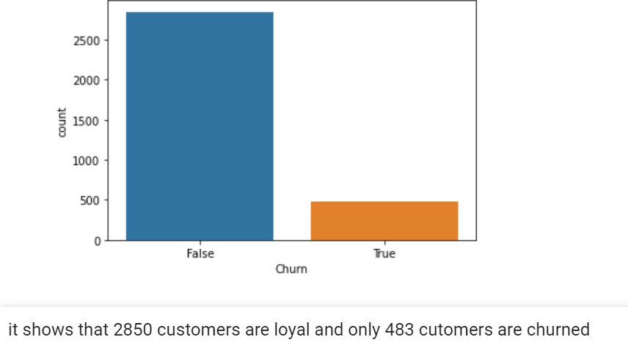
EDA
No of Churn customers out of total customers

Slide 11
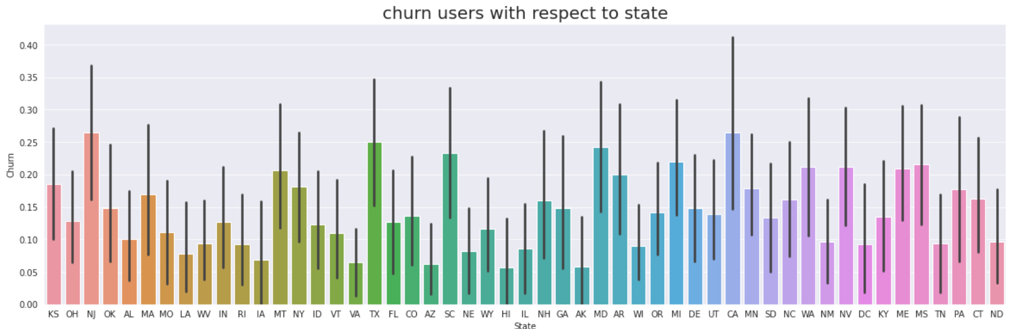
EDA

Slide 12
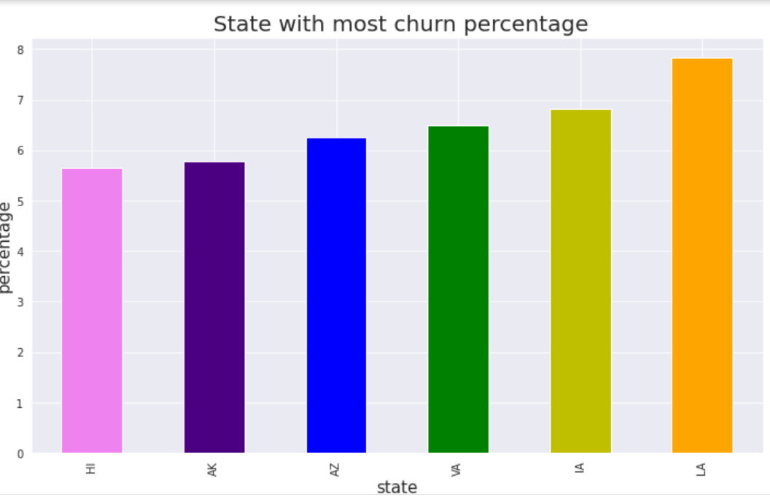
EDA

Slide 13
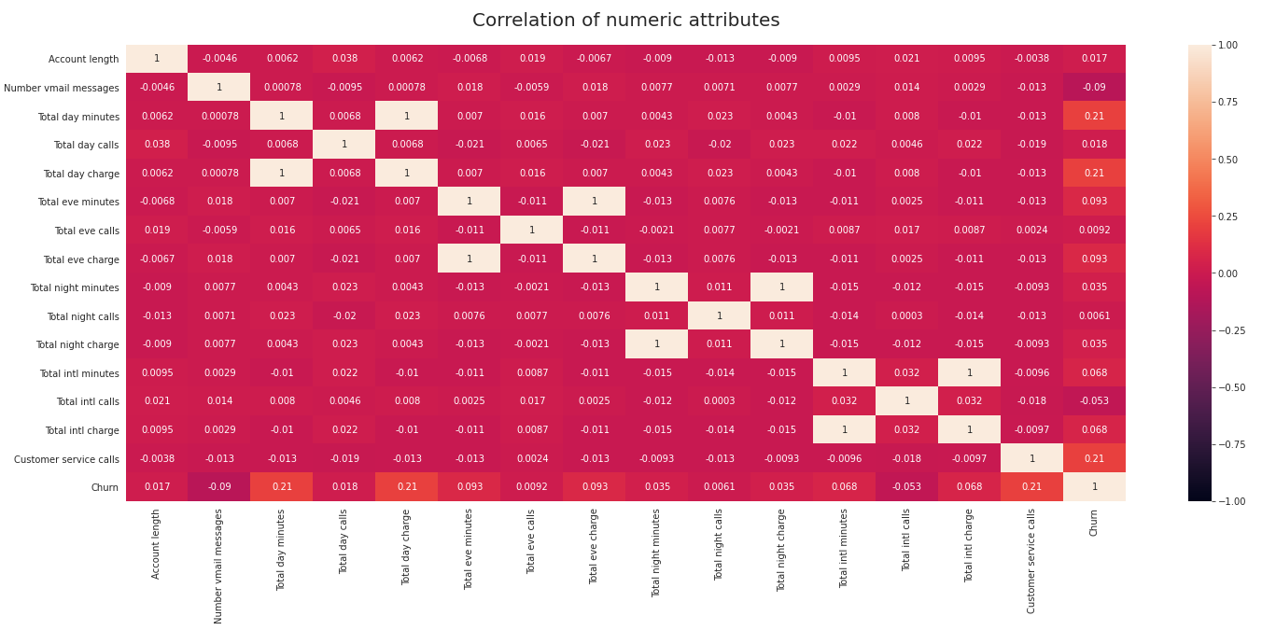
EDA
By plotting the heat map we can easily see there are correlation between some variables and churn:
Total Day charge to churn at 0.2
Total day minutes to churn at 0.2
Customer service calls to churn at 0.2
Total evening charge to total evening minutes at 1
Total day charge to total day minutes at 1

Slide 14
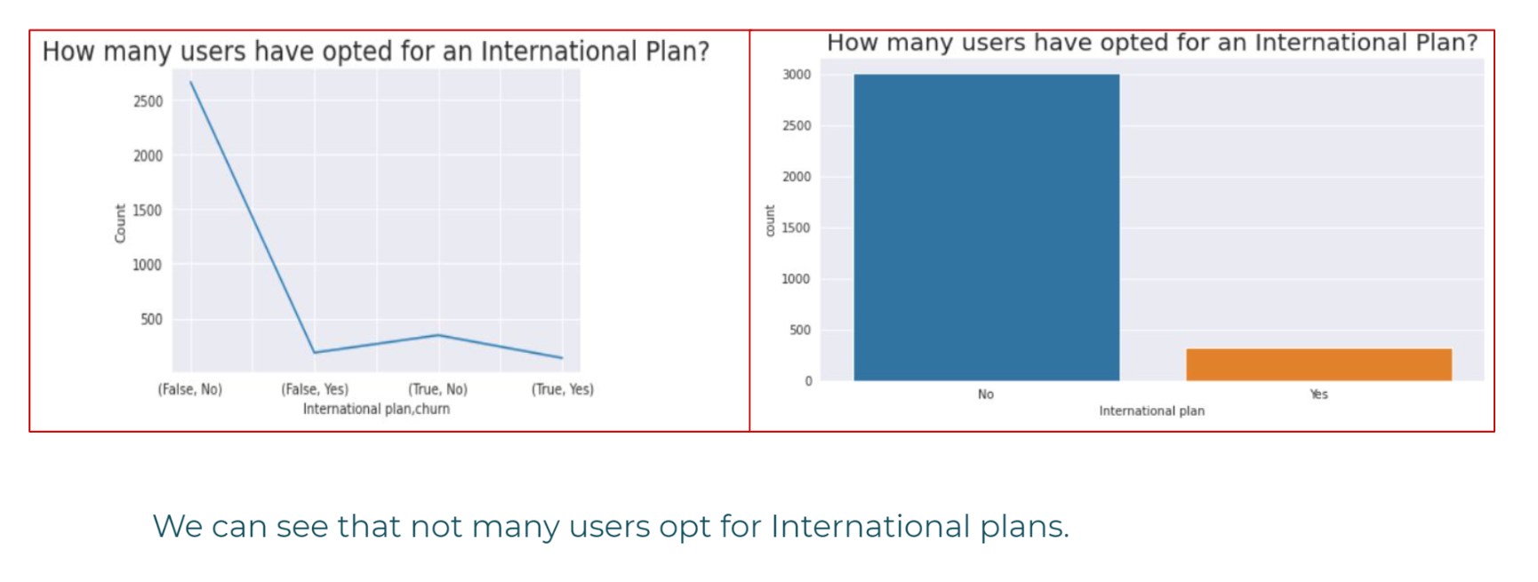
EDA

Slide 15
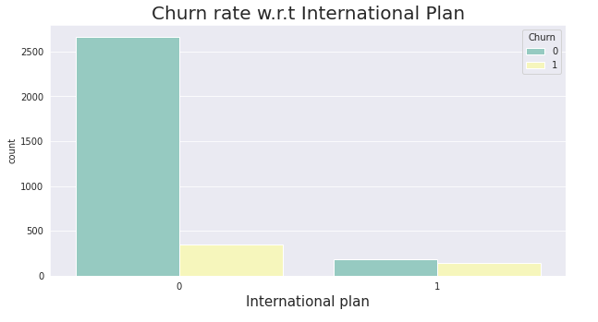
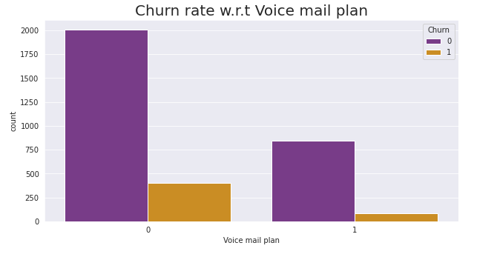

Slide 16
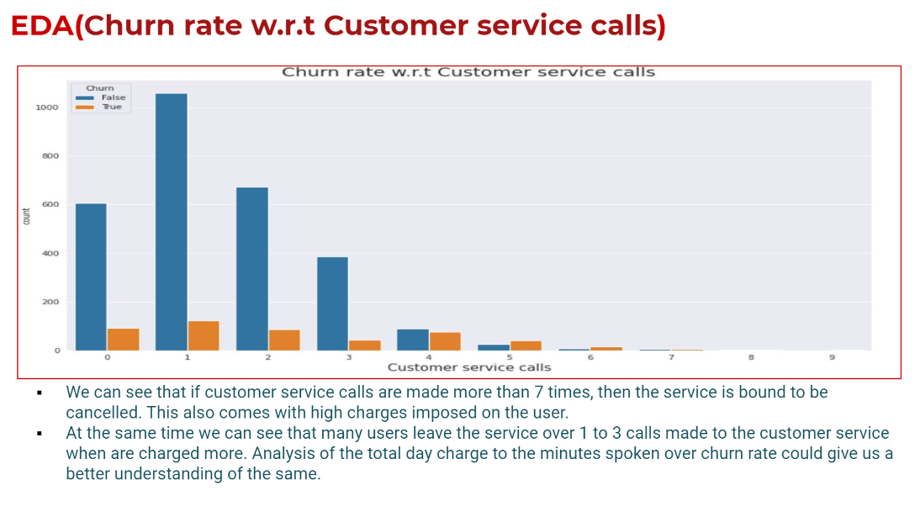

Slide 17
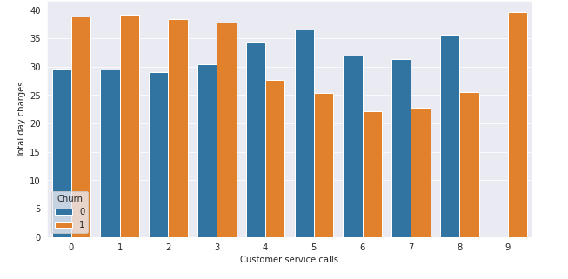
Some customers jump to other network without resolving the issue, while the customer who have called once , have high churn rate indicating their issue was not solved in first attempt. A Feedback is necessary in the situation. A confirmation should be given to the customer, that there issue will be solved in the first attempt.

Slide 18
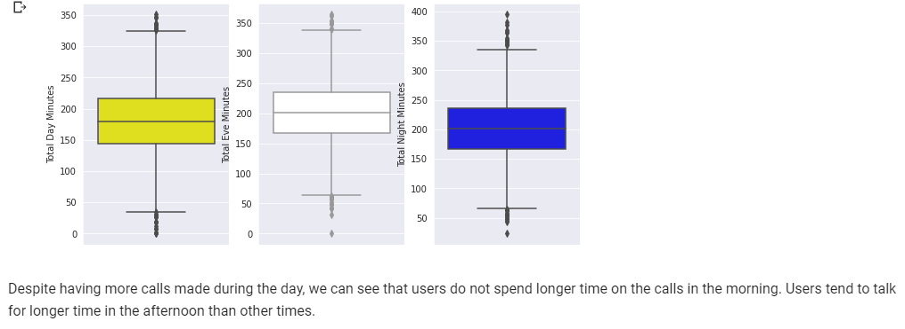
EDA(TOTAL CALLS ON DAY,EVE AND NIGHT)

Slide 19
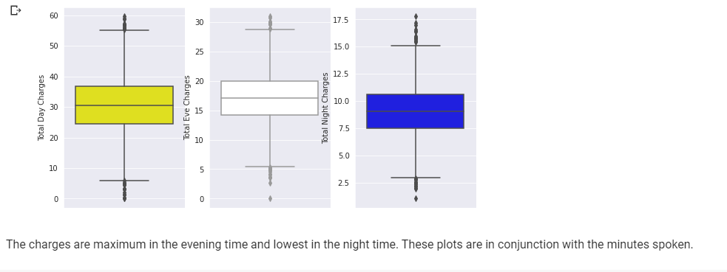
EDA(TOTAL MINUTES ON DAY,EVE AND NIGHT)

Slide 20
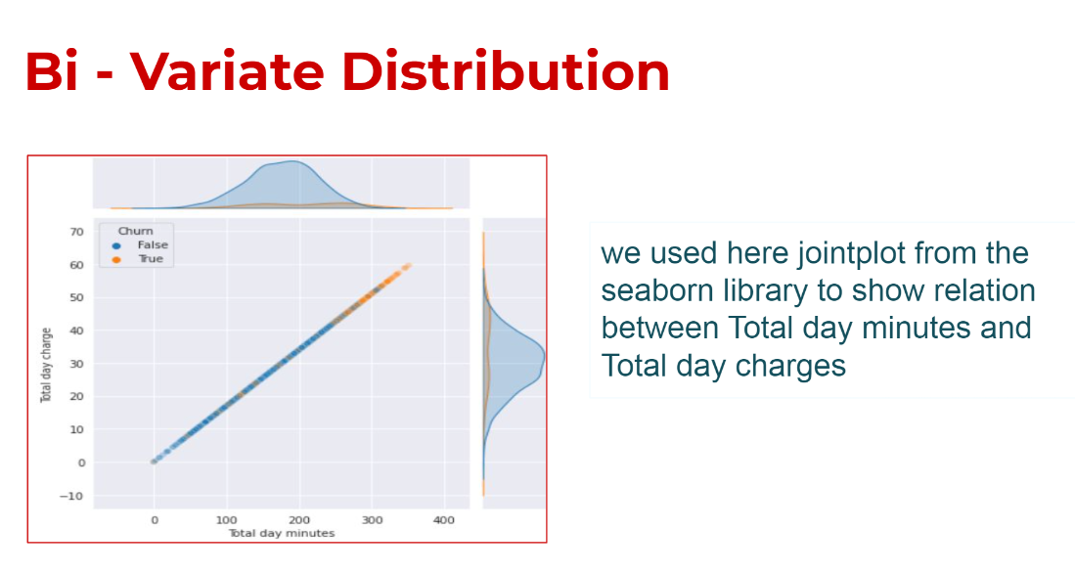
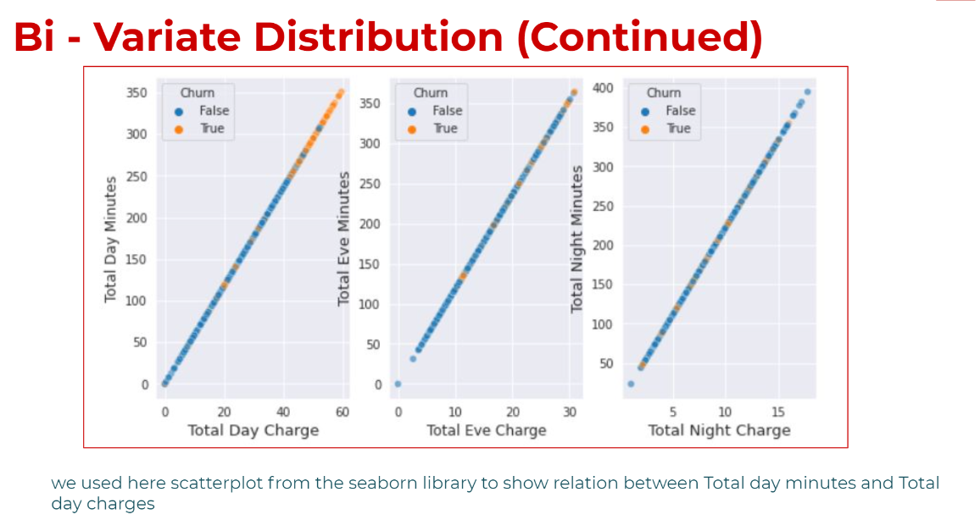

Slide 21
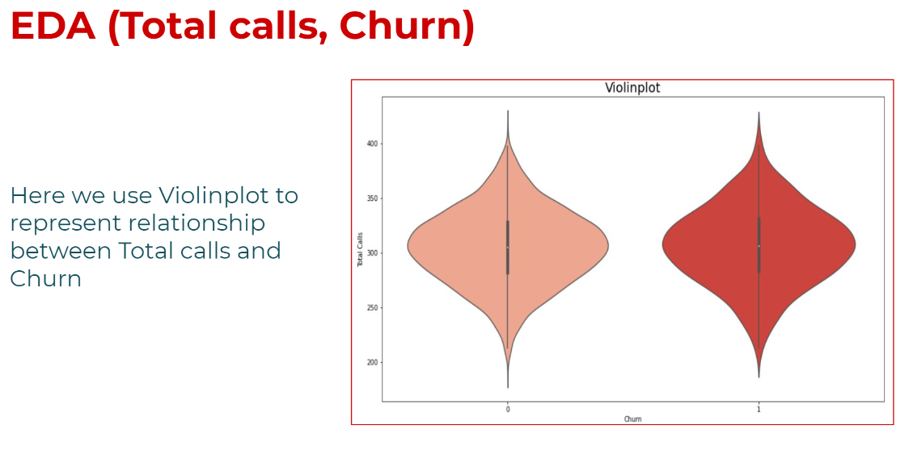

Slide 22
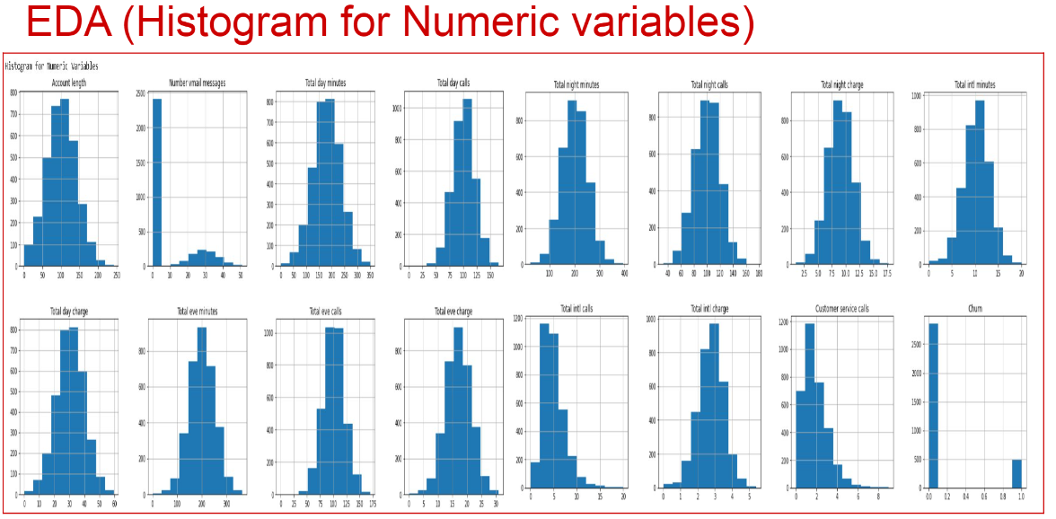

Slide 23
Solutions to reduce the customer churn
* Modify International Plan as the charge is same as normal one.
* Be proactive with communication.
* Ask for feedback often.
* Periodically throw Offers to retain customers.
* Look at the customers facing problem in the most churning states.
* Lean into best customers.
* Regular Server Maintenance.
* Solving Poor Network Connectivity Issue.
* Define a roadmap for new customers.
* Analyze churn when it happens.
* Stay competitive.

Slide 24
CONCLUSION
* It can also be observed that most people who use the service in the
morning speak for shorter amounts of time but make more calls.
* International plan users are more consistent with their churn w.r.t the ones who do not have the service.
* Customers with the International Plan tend to churn more frequently.
* Customers with four or more customer service calls churn more than four times as often as do the other customers.
* Customers with high day minutes and evening minutes tend to churn at a higher rate than do the other customers.
Q & A

